Slide 1
Navigation Application with AI (Pattern and Image Recognition)
Group 1:
- Indira Priyadarshini (is13658n@pace.edu)
- Kartik Kannan (kk96691n@pace.edu)
- Sunil (sm12210n@pace.edu)
- Pranav (pk73658n@pace.edu)
- Bharath (sv90693n@pace.edu)
- Rahul (rs15193n@pace.edu)
Sprint 1 Deliverable :
CS 691 - Computer Science Project 1
Prof. Henry Wong

Slide 2
Introduction:
Our Navigation Application with AI Project is an application which helps the end users to locate a picture and other such information related to the picture which is taken as an input. (address details, travel duration, office hours, redirecting to website, etc).
This application uses elements of Artificial Intelligence, which include pattern recognition and image recognition.
Example: A picture of Pace University should help the user locate it and also should bring up information such as the office hours, the official website page, etc.

Slide 3
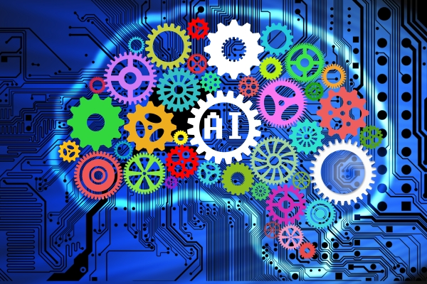
Artificial Intelligence:
Artificial intelligence (AI) refers to the simulation of human intelligence in machines that are programmed to emulate humans. The term may also be applied to any machine that has traits associated with a human mind such as learning and problem-solving.
The ideal characteristic of artificial intelligence is its ability to rationalize and take actions that have the best chance of achieving a specific goal.The goals of artificial intelligence include learning, reasoning, & perception. The applications for artificial intelligence are endless and are briefly explained in the next slide.

Slide 4
Applications of AI:
Reasoning: The ability to solve problems through logical deduction. Example: Games, Financial Application Processing, etc.
Knowledge: The ability to present knowledge about the world for everyone to access. Example: Financial market trading, purchase prediction, fraud prevention, medical diagnosis, media recommendation.
Planning: The ability to set and achieve goals. Example: Inventory management, demand forecasting, predictive maintenance, navigation, scheduling, logistics
Communication: The ability to understand spoken and written language. Example:.Smart assistants, voice control
Perception: The ability to infer things about the world via sounds, images, and other sensory inputs. Example:. medical diagnosis, autonomous vehicles, surveillance

Slide 5
Pattern & Image Recognition:
Pattern recognition is the automated recognition of patterns and regularities in data. A pattern can either be seen physically or it can be observed mathematically by applying algorithms.
Example: The colours on the clothes, speech pattern etc. In computer science, a pattern is represented using vector features values.
Image recognition, in the context of machine vision, is the ability of software to identify objects, places, people, writing and actions in images. Computers can use machine vision technologies in combination with a camera and artificial intelligence software to achieve image recognition.

Slide 6
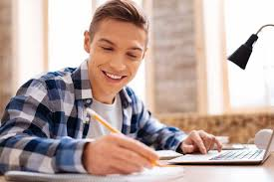
USER STORY 1:
Student name Sam, is a current graduate student at Pace University, New York City Campus. Sam had a small delay in, enrolling in the courses. He was only able to enroll in the class which is located in the Pleasantville campus, as the specific class he wanted to take, in NYC was full and closed. His class was located at the Goldstein Academic Center of the Pleasantville campus.
He can easily navigate himself to Goldstein Academic Center with contact details, office hours etc., by using scan picture option in our mobile application.

Slide 7

USER STORY 2:
John has parked his car in a parking lot at a new place where he has never been to and left for some work.When returned after hours from another exit, he’s lost where he had parked his car and unfortunately the car keys sound alarm doesn't work for his car,probably lazy to get it repaired earlier.With our project, pointing out the location and directing to the place is a goal to be accomplished.

Slide 8
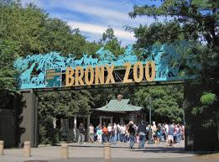
Persona:
User had a plan on visiting The Bronx Zoo, situated at 2300 Southern Blvd, The Bronx, NY 10460. The user is new to New York and thus has no knowledge about the zoo, nor the area. The user decides to use our application for him to navigate and also to know general information about the zoo. User then uses an image of Bronx Zoo as an input to scan. User receives details such as navigation, timings with our application. The user can also access the website which can help him purchase coupons, discounts/offers, pre book events and also other general information of adventures, and fun activities for kids/adults.

Slide 9
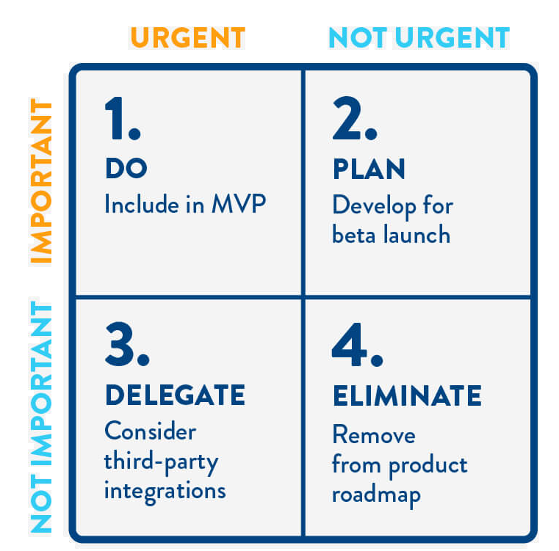
MVP (Minimum Viable Product)
A minimum viable product (MVP) is a development technique in which a new product or website is developed with sufficient features to satisfy early adopters. When considering which features to include, repurpose the Eisenhower Matrix for building MVP.
DO -Scan the picture and navigate with useful information
PLAN - Clone the Google API with required information in mobile application
DELEGATE- Consider third-party permitted applications
ELIMINATE - Remove multiple web pages and make it user friendly.

Slide 10
Project: Navigation Application
Retrospective:
What’s working well?
How could we improve?
We as a team, have planned to keep it an objective to finish and produce what was expected (Sprint1).
We are all on the same page with the work being done.
We frequently try to communicate to discuss about the project and the advancements.
We are all planning to update the github catalog with our updates.
We were able to successfully finish the week 1 work of our project schedule.
We would like to improve our team communication methods as we had issues regarding communication at the beginning of the class after adding new member. We would also like to improve our planning and be up to date with updates on the project. We plan on improving by
Sprint meetings with in time duration
Project research of cloning websites to overcome challenges
Every team member must follow meeting minutes
Utilizing team members experience and academic skills as a strength for project at right place.

Slide 11
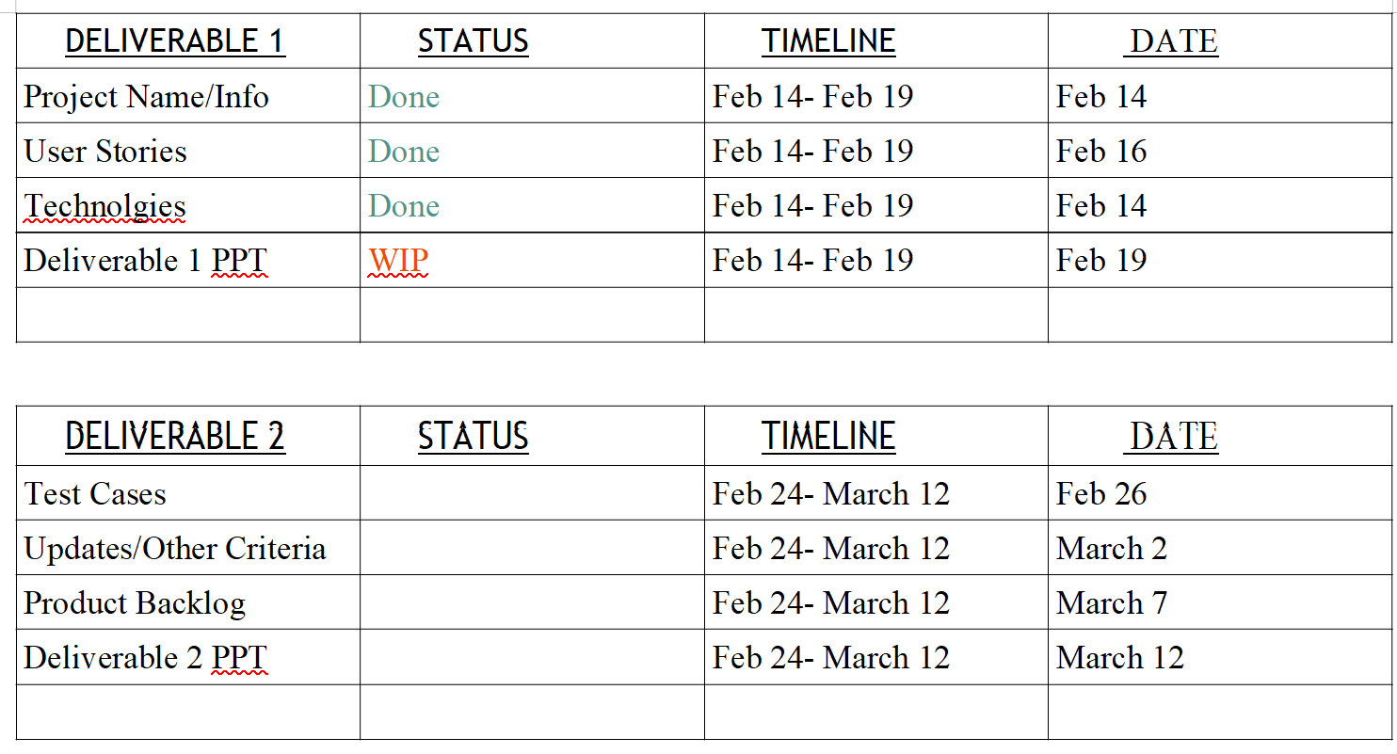
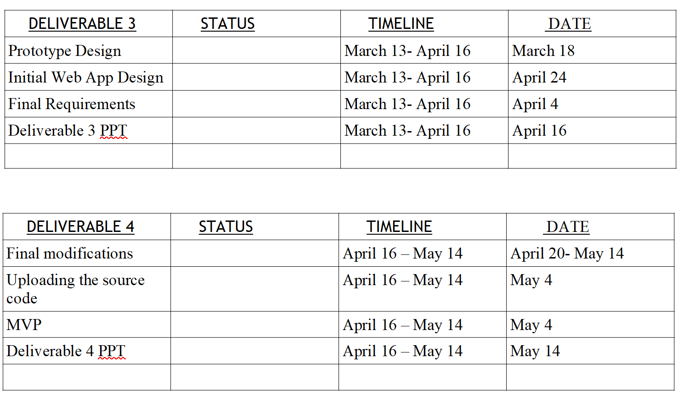
Schedule:

Slide 12
Tools:
Front end: HTML5, CSS3, Java Script
Back end: Python ( Server Side Programming Language)
RDBMS Technology: SQL
Testing Tools: Manual Testing by using Bugzilla, Postman (API Testing)
AI Image Recognition through python
Methodology: Agile
GITHUB LINK: https://github.com/Indirapriyadarshini/Navigation-Application-with-AI-Pattern-and-Image-Recognition-
Project progress will be update in Github

Slide 13
REFERENCES:
Introduction to Pattern Recognition and Machine Learning
By Charles Tappert, LTC Avery Leider, Seidenberg School of CSIS, Pace University:
https://indatalabs.com/blog/ai-image-recognition
https://thenextweb.com/artificial-intelligence/2018/07/18/a-beginners-guide-to-ai-computer-vision-and-image-recognition/
https://marutitech.com/working-image-recognition/
https://technical.ly/dc/2019/09/20/image-recognition-technology-artificial-intelligence/
https://builtin.com/artificial-intelligence
https://www.sas.com/en_us/insights/analytics/what-is-artificial-intelligence.html
https://www.technologyreview.com/artificial-intelligence/
https://imagga.com/blog/the-top-5-uses-of-image-recognition/
https://thenextweb.com/artificial-intelligence/2018/07/18/a-beginners-guide-to-ai-computer-vision-and-image-recognition/
https://blog.logograb.com/applications-image-recognition-never-heard-of/
https://sightcorp.com/knowledge-base/image-recognition/

